Slide 1

BC Code Reviewer – Final Presentation
Christina Nguyen
Michael Bloomquist
Sarah Ramazani
Travis Lamb

Slide 2

DESCRIPTION OF THE PROJECT

Slide 3
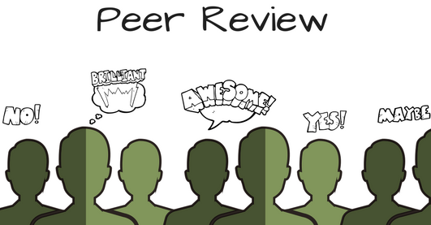

Slide 4
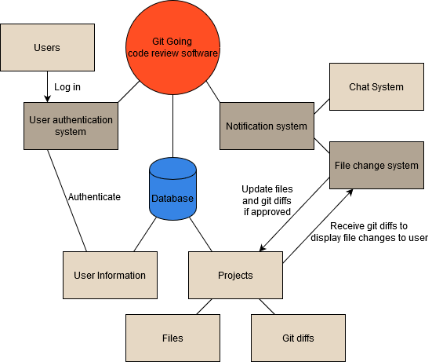
USER functional REQUIREMENTS
Registration
Login
Logout
Notification System
Chat System
File Change System

Slide 5
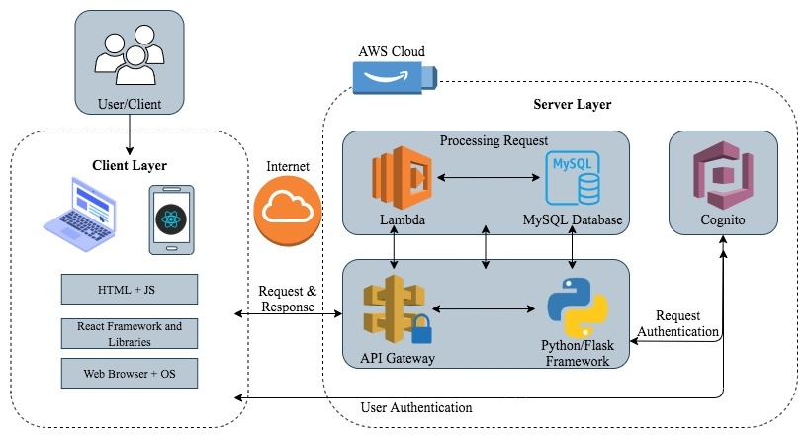
Architectural design
Client-Server pattern
Client layer: HTML, JS, React Frameworks etc.
Server layer: AWS cloud, API gateway.
Processing Request: Lambda and a MySQL database
Output: PC, smartphone, or laptop.

Slide 6


Techniques and technologies
Technologies:
Dependencies
React. MYSQL, AWS, Congnito
Flask, Node.js, Express.js
Techniques:
Event-Driven approach

Slide 7

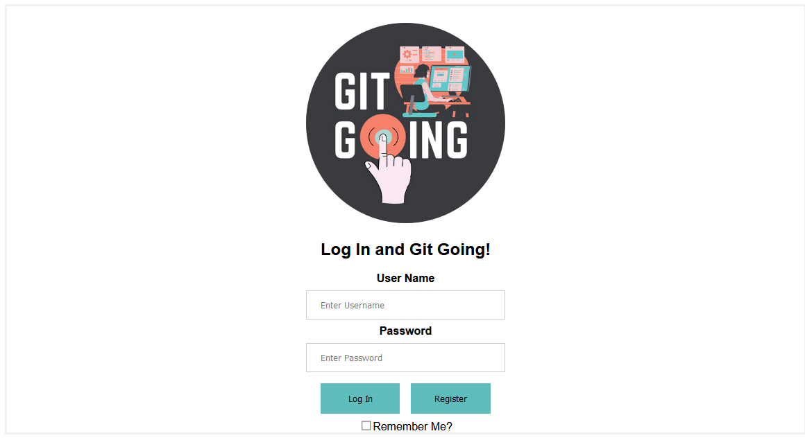
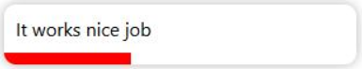
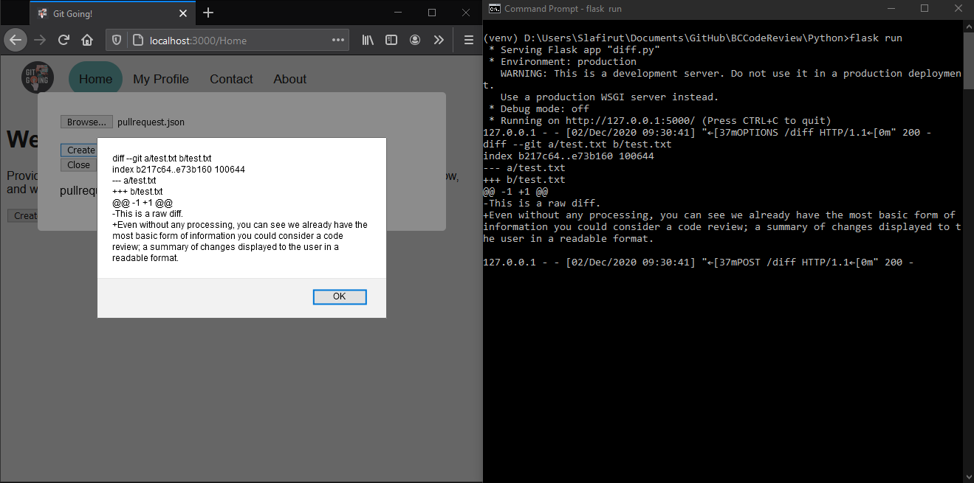
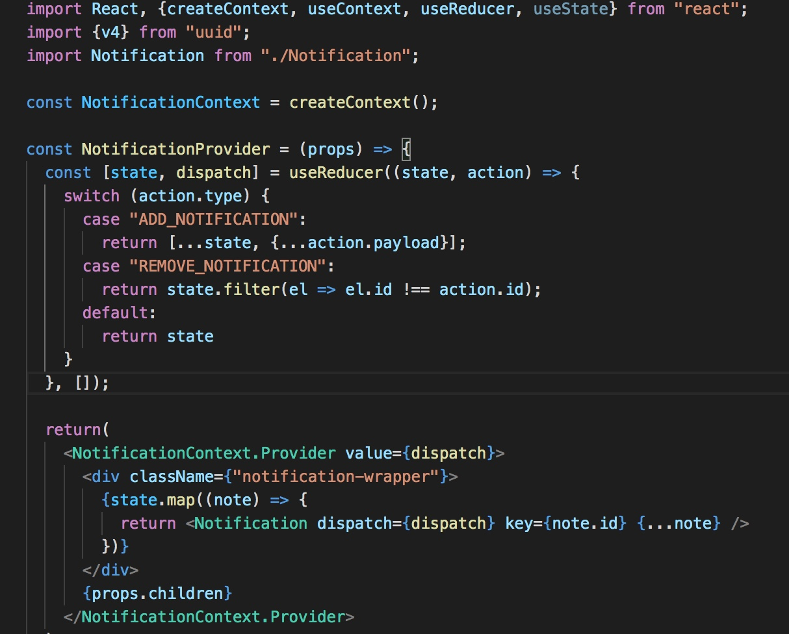
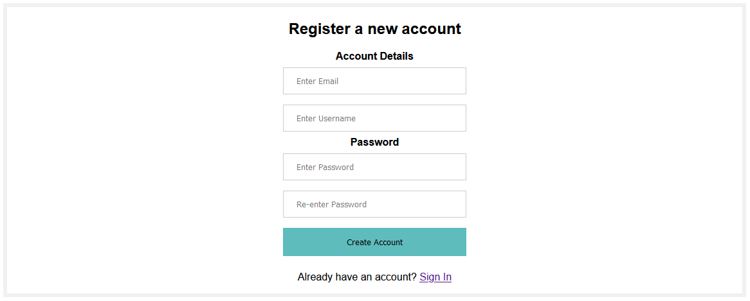
Our biggest coding achievements
Partially functioning login system
Notification System
Functioning registration system which pushes new user information into a hosted database with a POST request
Diff retrieval from a remote directory with a POST request

Slide 8
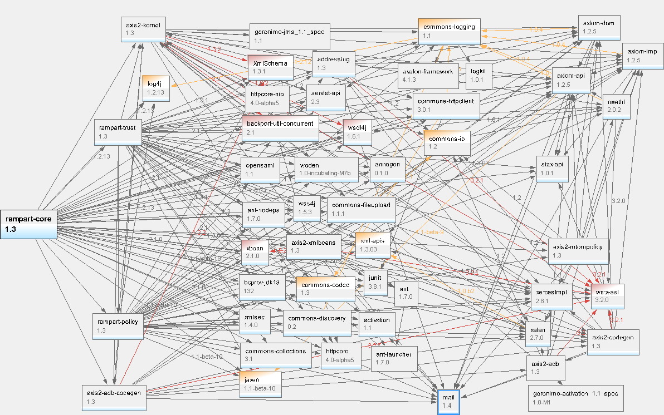
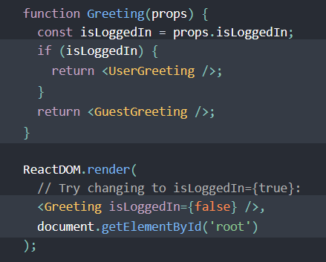



Testing efforts (headaches)
Conditional Rendering
Excessive, unsupported or unnecessary dependencies
Setting up APIs to transfer information between systems
Unexpected Obstacles

Slide 9
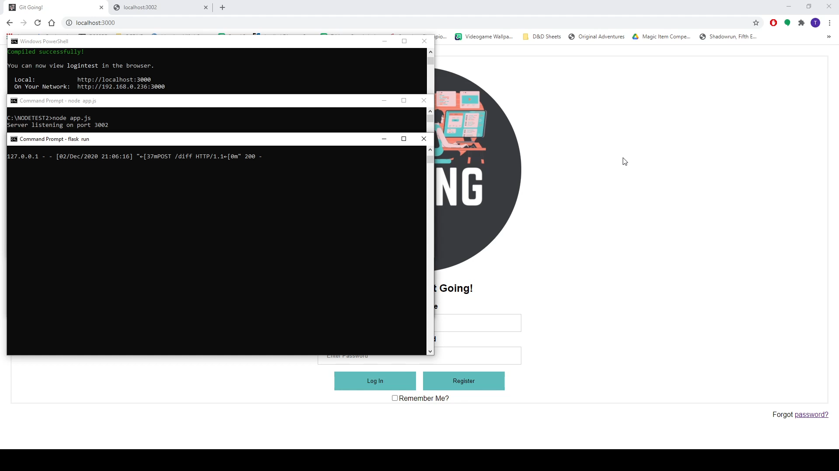
DEMO OF LOGIN FLOW AND CODE REVIEW A demonstration of the log-in flow and code review process in an extremely bare-boned setting. The usage of localStorage is a facsimile of a real authorization process without the API attached to it.
.

Slide 10

the road ahead
Integrate separated features
Hook log-in system up to authentication service
Rewrite DB API to handle secure retrieval of data
Introduce commenting system for reviews
Beautify systems in-place

